Slide 1
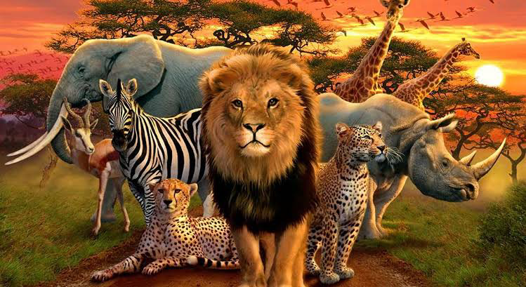
EXTINCT AND EXTINCT IN WILD
Team Members:-
Anas ahammaed
Akshai Shiju
Abhishek
Abhinayah
M.Harikrishnan

Slide 2
INTRODUCTION
Wildlife includes all animals that evolve or exist in the wild in an environment free of human intervention.All living things (except people) that are undomesticated.
Importance Of wild life :-
keep the food chain in place
Maintain Ecological stability
Maintains Diversity
Impact of human activities in Wild Life
Extinction Of Animal species
Loss of natural habitats of animals
Threatened the survival and lives of the protected species
The extinction of wildlife species will certainly have a fatal impact on human race as well

Slide 3
The International Union for Conservation of Nature
IUCN stands for International Union for Conservation of Nature and Natural Resources.
It is well known for Red data book. the species of organisms is grouped into several categories according to their need for conservation.
IUCN monitors the impacts of climate change on nature, and guides the conservation and restoration of ecosystems to help mitigate and adapt to it.
It has classified species into categories of Extinct, Extinct in wild, Critically Endangered, Endangered, Vulnerable, etc.
The IUCN Red List Categories and Criteria are intended for classifying species at high risk of global extinction. Red List which provides a systematic list of plants and animals into various categories.
It divides species into nine categories: Not Evaluated, Data Deficient, Least Concern, Near Threatened, Vulnerable, Endangered, Critically Endangered, Extinct in the Wild and Extinct.

Slide 4
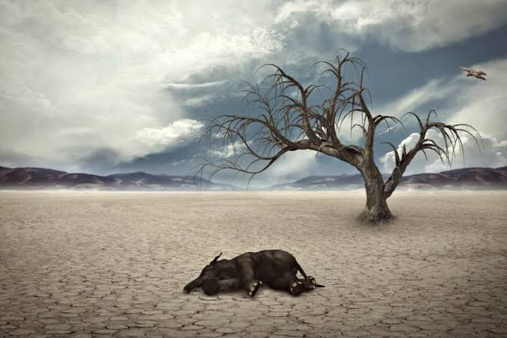
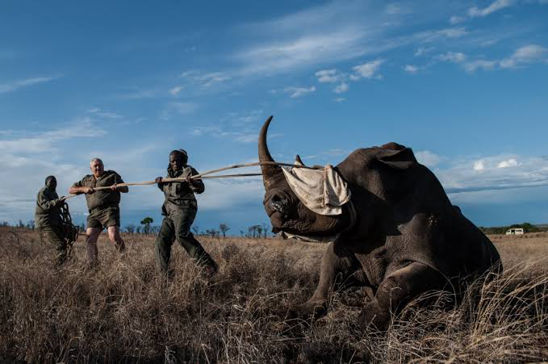
EXTINCT
Extinction is the elimination of species from the earth’s surface. It occurs when species disappear due to natural calamities or evolutionary changes of their relatives.
Extinct animals are species that don't have a single living member left, either in the wild or in captivity.

Slide 5
REASONS BEHIND EXTINCTION
1)Natural Causes
Change in Climate
Change in Sea Currents
Asteroids
Disease
Invasive Species
Reduced Genetic Diversity
Lack of Adaptive Skills
2) Human Causes
Pollution
Loss of Habitat
Over harvesting

Slide 6
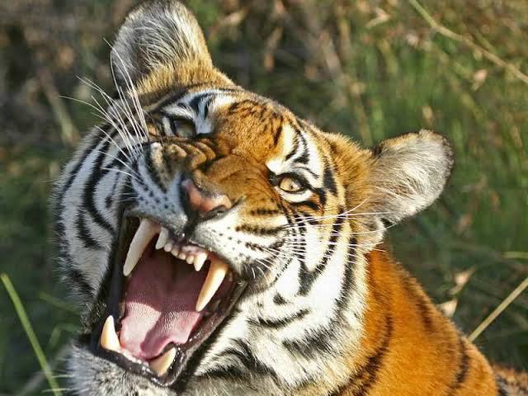
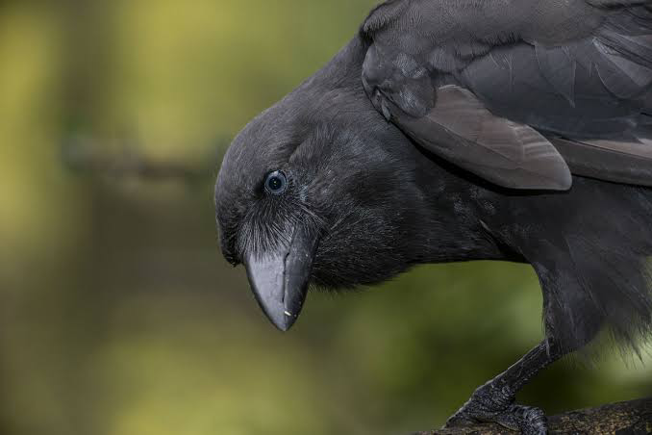
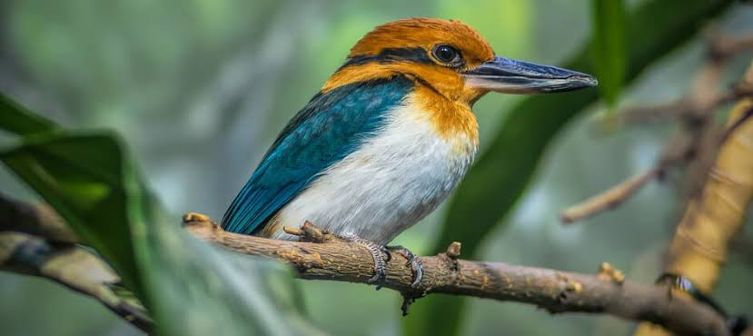
EXTINCT IN WILD
Extinct in the Wild (EW) is a conservative status given to a species, a group of plants or animals, when the only known living members are being kept in captivity (kept in a zoo or aquarium, or planted in pots), or they are no longer living in their normal habitat.
South China Tiger, Guam Kingfisher,Hawaiian Crow are few of the examples of Extinct in wild.

Slide 7
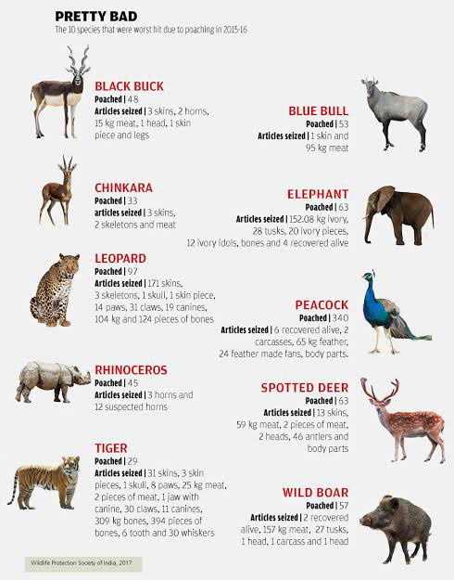
REASONS BEHIND EXTINCT IN WILD
Destruction of wild habitats
Hunting and illegal trafficking
Pollution

Slide 8
CONCLUSION
Forests and wildlife are the renewable natural resources.
If all the planned programs are effectively executed, in a few decades the flora and the fauna will start flourishing.
Save animals.
Save trees.
Many national have reached bilateral / multilateral agreements and have framed rules and regulations for protection and conservation of wildlife.

Slide 9
REFERENCE
A brief Introduction to Wildlife conservation. (2022, May 27). Unacademy. https://unacademy.com/content/cbse-class-11/study-material/geography/wildlife-conservation-and-its-importance/
Extinction: Definition, causes and examples - collegedunia. (n.d.). https://collegedunia.com/exams/extinction-biology-articleid-293 .
Kotiyal, P. (2021, June 4). Reasons why we need to save wildlife | Wildlife Conservation | Tour My India. Tour My India. https://www.tourmyindia.com/blog/reasons-to-save-wildlife/
The International Union for Conservation of Nature (IUCN). (n.d.). UNEP - UN Environment Programme. https://www.unep.org/explore-topics/oceans-seas/what-we-do/working-regional-seas/partners/international-union#:~:text=IUCN%20is%20at%20the%20forefront,and%20guide%20conservation%20action%20worldwide
A brief Introduction to Wildlife conservation. (2022b, May 27). Unacademy. https://unacademy.com/content/cbse-class-11/study-material/geography/wildlife-conservation-and-its-importance/
Wikipedia contributors. (2023). Extinct in the wild. Wikipedia. https://en.m.wikipedia.org/wiki/Extinct_in_the_wild#:~:text=A%20species%20that%20is%20extinct,due%20to%20massive%20habitat%20loss.

Slide 10
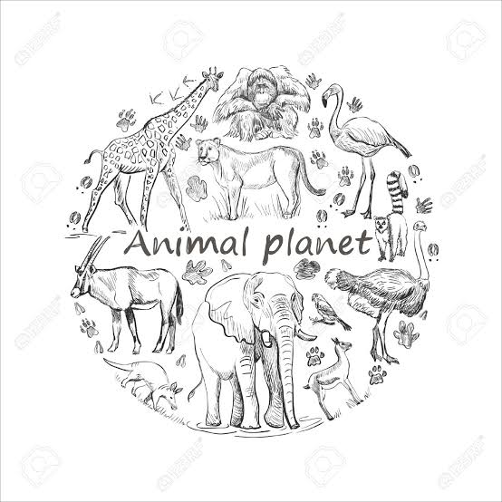
THANK YOU❗️❗️❗️

